Slide 1

Disk and Memory Digital FORENSICS Analysis
[KH5036CMD]
[Hala Ahmed Sayed] | [202300277]
[Haitham Ghalwash]
[Kareem El Debassy]

Slide 2
OBJECTIVE
Investigate 2 cases while showcasing the process, evidence and findings
Case 1: Disk Image Analysis
Case 2: Memory Analysis

Slide 3

Table OF CONTENTS
INTRODUCTION
METHODS AND TOOLS
FINDINGS
CONCLUSION

Slide 4
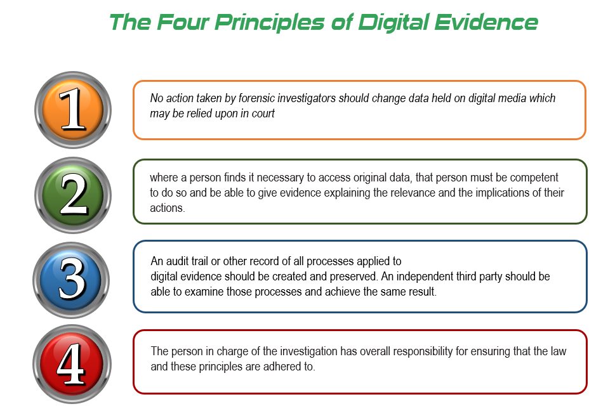
Introduction
Digital forensics= digital investigations for incident response or legal procedures
Investigation conducted under UK ACPO principles
Case 1: Internal Date Leakage Suspicion
Case 2: Steganography and cryptography suspected behavior

Slide 5
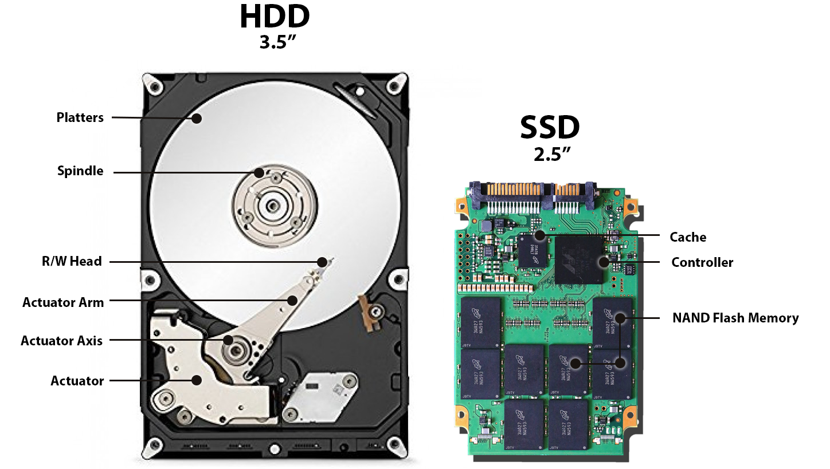
CASE 1:DATA LEAKAGE
Case Number: 1
Suspect: Iaman (Employee)
Investigation Date: 26 November 2025
Report Date: 3 December 2025
Evidence:
20GB Windows 7 disk image
Static acquisition on 16/11/2025 at 02:29 AM
MD5 Hash: a49d1254c873808c58e6f1bcd60b5bde
SHA1 Hash: afe5c9ab487bd47a8a9856b1371c2384d44fd785
Key Finding:
Iaman is a malicious insider actor intentionally leaking confidential data

Slide 6

CASE 2:Memory DUMP ANALYSIS
Technical Details:
Memory Image: 1,023,936 KB raw dump file
Operating System: Windows 7, x86 architecture
Acquisition Date: 30 September 2018
Analysis Date: 14/12/2025
MD5 Hash: D2D6369341982E59B2BF0C77E4A0D820
Objectives:
Analyze memory image for hidden artifacts
Investigate cryptographic and steganographic procedures
Extract hidden password and secret text
Document analysis flow and methodology

Slide 7
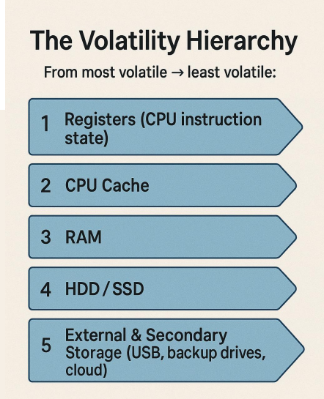
METHODS AND TOOLS case 1
Registry Analysis:
Examine Windows registry for user accounts and configurations
Identify installed applications and system settings
Analyze six user accounts on system
Review browser and email client installations
File System Analysis:
Examine file extensions and timestamps
Identify encrypted files and anomalies
Analyze non-working hours access (March 22-25, 2015)
Detect privilege escalation during late-night hours
Email Analysis:
Examine email communications between accounts
Analyze 14 emails exchanged March 23-25, 2015
Identify discussions about data leakage methods
Track transfer methods: USB, cloud, email
Web Activity Analysis:
Investigate browser history and search queries
Identify research on data leakage methods
Detect anti-forensics techniques research
Track cloud service downloads during non-working hours
Cloud Service Analysis:
Examine Google Drive and iCloud transfers
Analyze synchronization logs
Track file downloads and timestamps
Nine files downloaded 21:55-21:56 EET
USB Device Analysis:
Identify USB device connections
Analyze data transfer patterns
Detect 16 USB devices including SanDisk drives
Tools Used:
•FTK Imager, PowerShell, Autopsy
•Registry Viewer, Event Viewer, Disk Editor

Slide 8
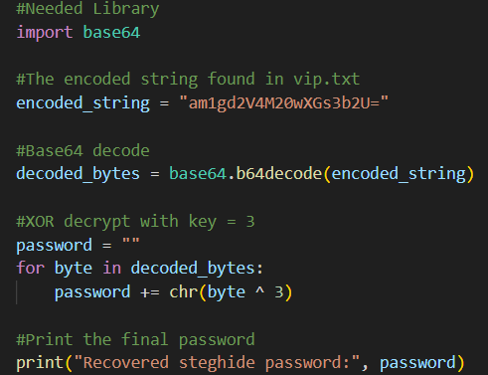
METHODS AND TOOLS case 2
Memory Image Analysis:
Use Volatility framework for analysis
Identify operating system and architecture
Analyze 95+ running processes
Examine network connections from IP 10.0.2.15
Process Analysis:
Examine running processes for suspicious activities
Analyze notepad.exe (PIDs 3432, 3736)
Track explorer.exe (PID 5300) browser process
Identify Dump.it memory acquisition tool (PID 4116)
File Extraction:
Use Volatility filescan and dumpfiles plugins
Extract vip.txt and evilscript.py from memory
Analyze embedded memory data in files
Cryptographic Analysis:
Identify XOR operations with key 3
Detect Base64 encoding applied to output
Analyze encryption algorithms used
Steganography Analysis:
Use Steghide tool for extraction
Analyze suspicion1.jpeg JPEG image
Extract hidden data using passphrase
Network Analysis:
Use netscan for network connections
Identify internet connections
Detect potential data exfiltration channels
Tools Used:
•Volatility, Steghide, PowerShell
•Python scripts for cryptographic analysis

Slide 9
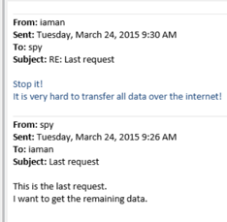
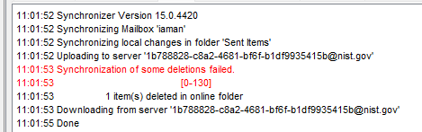
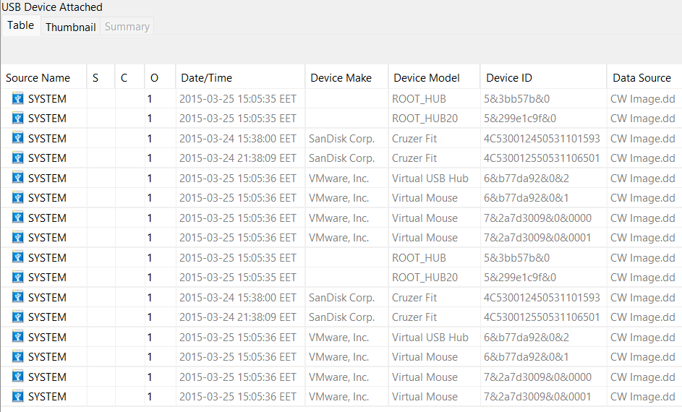
Disk Image Investigation Findings
Registry and System Evidence:
•Six user accounts identified on system
•Non-working hours access: March 22-25, 2015
•Two web browsers: Chrome and Internet Explorer
•Two email clients: Outlook and Windows Mail
•Suspicious processes: Eraser, Cleaner applications
•"Secret Project" folder with confidential documents
•Resignation letter document found
File analysis:
•13 encrypted files discovered
•77 files with mismatched extensions
•10 deleted files in Recycle Bin
•Forensics PDF from 2012 found
•"Data Leakage - Threats and Mitigation" document
Unauthorized Data Transfer:
•16 USB devices detected (2 SanDisk drives)
•Virtual machine setup detected
•Google Drive and iCloud transfers
•Email synchronization tricks to avoid detection
Email Communications:
First email: March 23, 2015, at 19:29:29 EET
Email exchanges: 21:15:00 - 22:41:22 EET
14 emails between informant and spy accounts
Discussions about data leakage files and methods
Transfer methods: USB, cloud, email
Synchronization logs manipulated
Web Activity:
Searches for data leakage methods and techniques
Anti-forensics techniques research on March 23, 2015
Intellectual property theft concepts searched
9 files downloaded from cloud services
Downloads during non-working hours: 21:55-21:56 EET
Eraser and executable files downloaded
Conclusion:
Iaman intentionally leaked confidential data to external parties
Resignation letter retrieved March 24, 2015, at 20:00
Evidence demonstrates malicious intent
Knowledge of digital forensics and circumvention of policies

Slide 10

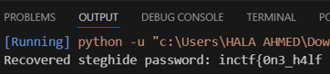
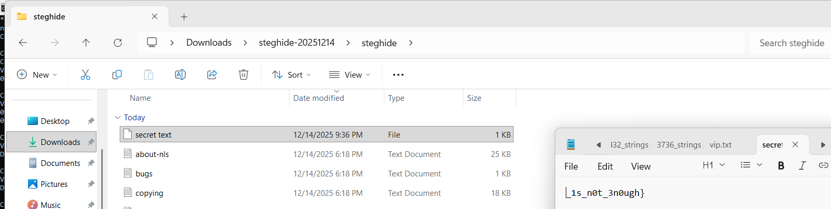
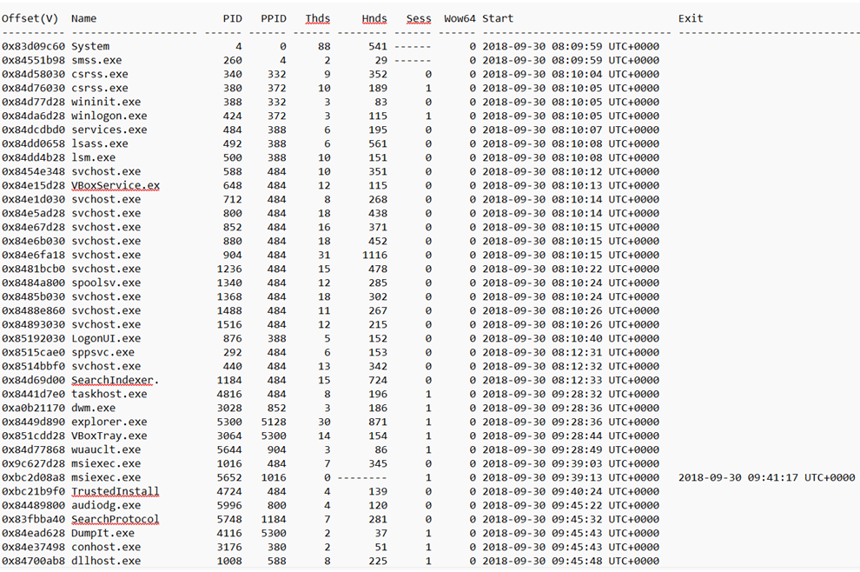
Memory Dump Analysis Findings
System Information:
•OS: Windows 7, x86 (32-bit)
•Processors: 1
•95+ running programs analyzed
•Machine IP: 10.0.2.15
•Internet connections detected
Running Processes:
•Process 3432: notepad.exe (Parent: PID 5300)
•Process 3736: notepad.exe (Parent: PID 5300)
•Process 4116: Dump.it (memory acquisition tool)
•Process 5300: explorer.exe (browser)
File Extraction Results:
•Notepad opened multiple suspicious files
•Static cache files identified
•Large portions of memory data embedded in files
•Process chain: Browser → dumpit.exe → notepad → suspicious files
•Indicates data transfer via downloaded files
Cryptography Results:
Identified suspicious notepad.exe processes (PIDs 3432, 3736)
Extracted evilscript.py from memory
Decryption: Base64 decoding + XOR operation with key 3
Extracted Password: inctf{0n3_h4lf
Steganography Results:
Suspicious JPEG image: suspicion1.jpeg
Steghide analysis revealed hidden information
Password used as passphrase for extraction
Extracted Secret Text: 1s_n0t_3n0ugh}
Combined Message:
inctf{0n3_h4lf is 1s_n0t_3n0ugh}

Slide 11
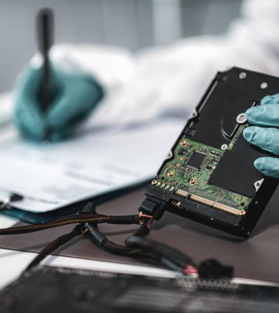
Conclusion
Disk Investigation:
Confirmed Iaman as malicious insider leaking data
Multiple evidence streams: registry, files, email, web
Data transferred via USB, cloud, and email
Intentional circumvention of security measures
Memory Analysis:
Identified suspicious processes and file operations
Extracted encrypted password from memory
Recovered hidden text from steganographic JPEG
Demonstrated cryptographic and steganographic techniques

Slide 12
Thank you
Hala Ahmed Sayed
hm2300277@tkh.edu.eg
https://github.com/hala-ahmedd/DIGITAL-FORENSICS-PYTHON-

